Slide 1



Lesson 10: React (Part 1)
<Web />
Front-end
Development
University of Tehran
Lecturer:
Misagh Mohaghegh
ACM
Summer of Code 2024

Slide 2
A Short Review…
Local Storage
Object properties and methods
Object accessors (getters and setters)
Object constructor function
Instanceof
Object prototype chain and own properties
Classes
Class inheritance
Static properties and methods
"use strict";

Slide 3
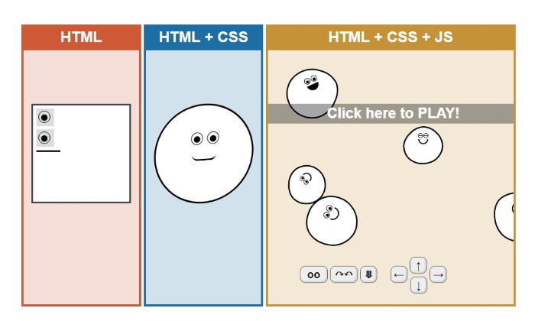

Time for…

Slide 4

JavaScript

Slide 5
Modules

Slide 6
Modules
Modules were introduced in ES6 which allowed us to break our JS code into separate files.
This makes the codebase easier to maintain.
To use them, each JS file can export some variables, functions, or classes.
Other JS files can import the exported things of other files.
There always exists a top-level JS file which imports other JS files (and those can also import other files)
After the browser gets the top-level file, it makes requests to get the imported files.

Slide 7
Export
To export a variable, function, or class, we use the export keyword either next to the declaration, or at the end of the file:
export const myVar = 10;
export function myFunc() { return 10; }
const myVar = 10;
function myFunc() { return 10; }
export { myVar, myFunc };
This is called a Named Export.

Slide 8
Default Export
We can have exactly one default export in our file:
export default function myFunc() {
return 10;
}
function myFunc() {
return 10;
}
export default myFunc;

Slide 9
Import
We can now import whatever was exported in other files.
// util.js
export function myFunc() {
return 10;
}
// main.js
import { myFunc } from "./util.js";
console.log(myFunc()); // prints 10
// multiple imports
import { myFunc, myVar } from "./util.js";

Slide 10
Default Import
To import a default exported variable, we emit the curly braces and can use any name:
// util.js
export default function myFunc() {
return 10;
}
// main.js
import whatever from "./util.js";
console.log(whatever()); // prints 10

Slide 11
Import Alias
We can also change the name of a normal named export when importing:
// util.js
export function myFunc() {
return 10;
}
// main.js
import { myFunc as test } from "./util.js";
console.log(test()); // prints 10
The same can be done when exporting:
export { myVar as anotherName };

Slide 12
HTML Script
To use modules, we need to specify that our script should be treated as one.
Otherwise it will not run the import statements.
<script src="main.js" type="module"></script>

Slide 13
Bundling

Slide 14

Bundling
For every module file that we have, the browser makes a request to get it. This is not very efficient.
This problem grows as our codebase grows and we have more files and more libraries.
JS bundlers turn all of our modules into a single JS file that the browser requests.
We do not change our code and still use modules like we used to.
The bundler will give us a code that has changed to work with a single compiled JS file.
Webpack is the most famous JS bundler.
There are other options such as Vite, Parcel, Esbuild, SWC, and Rollup.
Bundlers also support Sass (turn Sass files into a single CSS file)

Slide 15
Minification
Bundlers usually perform code minification.
Minification removes all comments and unnecessary whitespaces.
This leads to a much smaller file size for our code.
A smaller code means that the HTTP request will get the response faster.
The browser will also execute the code faster.
HTML, CSS, and JS all get minified for production use.
Minification is not used for development because it reduces code readability.

Slide 16
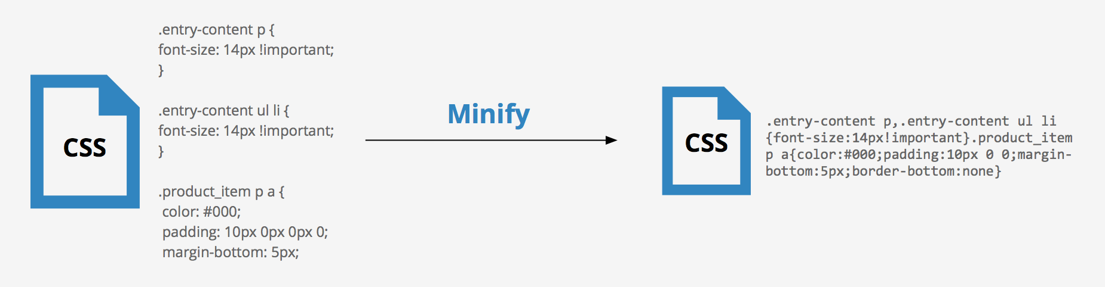
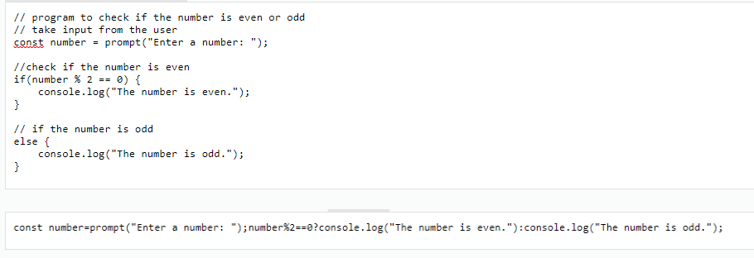
Minification

Slide 17
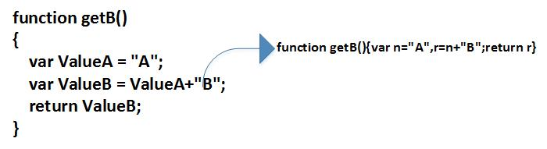
Uglification
JS code can also be 'uglified' using tools such as UglifyJS.
This process changes the variable names to smaller 1 character names.
This makes the code almost unreadable but reduces the file size.

Slide 18
Transpilation
We have already talked about transpilation.
Tools such as Babel convert our JS code into JS code that does not use the latest ECMAScript features.
This helps us use the latest features while providing support for older browsers through polyfils.
TypeScript also compiles to JavaScript to run on the browser.
// using ECMAScript 2020
// nullish coalescing operator
const x = addr ?? "none";
// transpiled code
const x = (addr !== null && addr !== undefined) ? addr : "none";

Slide 19
React

Slide 20
Imperative vs Declarative

Slide 21
Imperative vs Declarative
Imperative code specifies how to do what we want. This is done through step-by-step codes.
Declarative code specifies what we want. There is no focus on how it should be done.
const myList = [1, 2, 3];
// Imperative
let total = 0;
for (let x of myList) { total += x; }
// Declarative
let total = sum(myList);

Slide 22
Imperative UI
In an imperative design, we specify how to do things in a step-by-step manner.
What we have been doing to change our UI in JS was using an imperative paradigm.
For example, in our to-do list, we would add the item to a list and then to the DOM manually.

Slide 23
Declarative UI
In a declarative approach, we specify what the final state should be.
For example, we specify that a heading should have the value of a variable called h1text.
If we change the variable, we should select the heading and change its text.
But in a declarative UI, after changing the variable, the heading text changes automatically.
So only the final state was described and changes to reach that state happen automatically.

Slide 24
State
The variable we talked about (h1text) would then be called a state for our view.
Whenever a state changes, the components that use the state are updated accordingly.

Slide 25
React

Slide 26

React
React is a JS framework for building user interfaces using components.
It is an open-source project created by Meta (Facebook) in 2013.
It uses a declarative UI approach and components.

Slide 27
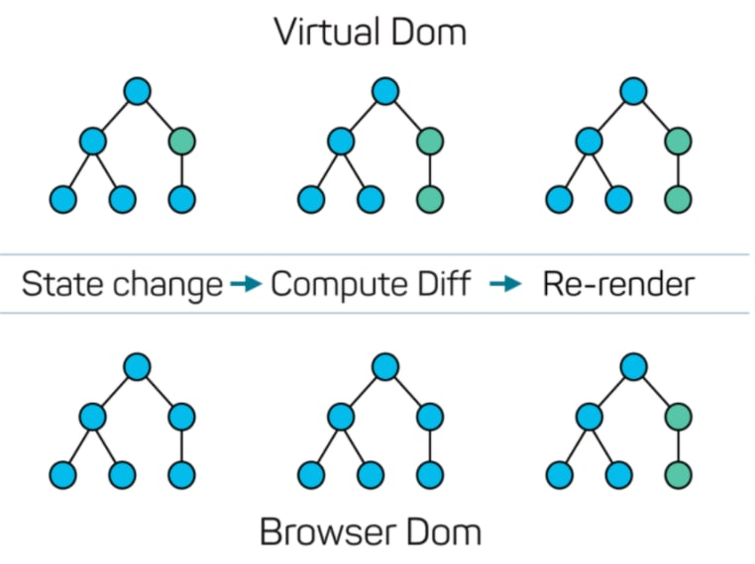
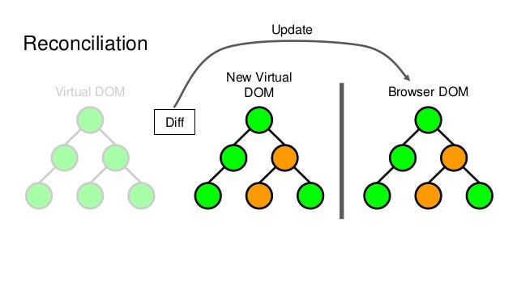
Virtual DOM
React uses a virtual DOM (which is a lightweight version of DOM in an object) to apply your changes.
The virtual DOM does not change the page.
After the virtual DOM changes, React checks the differences and updates only the changed parts in the real browser DOM (Reconciliation).
This method is used to make updates faster.

Slide 28
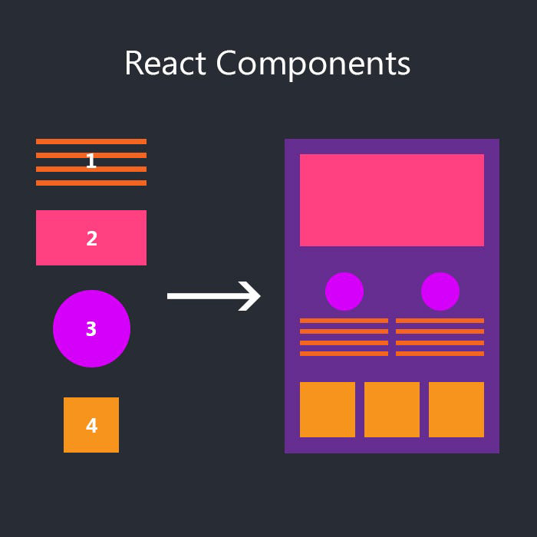
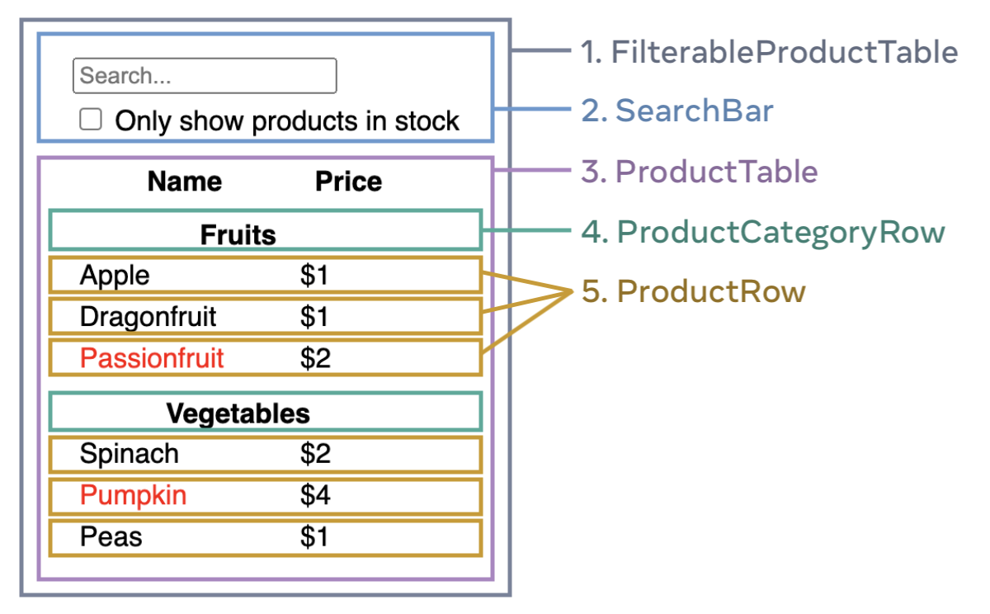
Thinking in Components
In React, we break down our code into many components.

Slide 29
JSX
JSX (JavaScript XML) is a syntax extension to JS that React uses to describe the UI.
Using JSX, we basically include HTML inside of JS code.
We can use curly braces {} to put JS code inside the JSX HTML.
const element = <h1>Hello, world!</h1>;
function func(link) {
let name = "me";
return <a href={link} title="test">Hi {name}!</a>
}

Slide 30
JSX Void Elements
We should close void elements like XHTML:
<img src="file.png" alt="picture"> // invalid
<img src="file.png" alt="picture" /> // correct
<br> // invalid
<br /> // correct
<input type="text"> // invalid
<input type="text" /> // correct

Slide 31
Components
In React, components are basically JS functions that start with a capital letter and return HTML code.
They can be used just like HTML elements.
HTML elements are lowercase while React components are capitalized.
function ListItem() {
return (
<li>
<img src={photo} alt="sample photo" />
<p>Example text</p>
</li>
);
}
function MyList() {
return (
<div>
<h1>This is my list</h1>
<ListItem />
<ListItem />
</div>
);
}

Slide 32
Fragment
The React.Fragment element (<>) is used to group same-level elements when returning:
function Hero() {
return (
<>
<h1>Hi!</h1>
<p>Welcome!</p>
</>
);
}

Slide 33
Props
Props or properties are arguments passed to components:
function ListItem({ imgSrc, text }) {
return (
<li>
<img src={imgSrc} alt="sample photo" />
<p>{text}</p>
</li>
);
}
function MyList() {
return (
<div>
<h1>This is my list</h1>
<ListItem imgSrc="https://a"
text="The Sea!" />
</div>
);
}

Slide 34
Prop Default Value
Props can have default values.
If a prop is not passed and does not have a default value, undefined is used.
function Sample({ text, size = 10 }) {
return (
...
);
}

Slide 35
Children Prop
The children prop contains all child elements of a component.
function Container({ children }) {
return (
<div className="container">
{children}
</div>
);
}
function Sample() {
return (
<Container>
<h1>Child element</h1>
</Container>
);
}

Slide 36
Class Components
Before React 16.8 (2019) introduced Hooks, class components were mostly used.
Function components should be preferred as of now.
class Greeting extends React.Component {
render() {
return <h1>Hello, {this.props.name}!</h1>;
}
}
// the same in function components:
function Greeting({ name }) {
return <h1>Hello, {name}!</h1>;
}

Slide 37
Rendering Lists
We need to use loops to render lists. It is common to use .filter and .map methods.
const items = [
{ id: 1, name: 'A' },
{ id: 2, name: 'B' }
];
function MyList() {
const listItems = items.map(x =>
<li key={x.id}>{x.name}</li>
);
// we could also use a (for x of items) loop and
// push HTML elements to the array
return <ul>{listItems}</ul>;
}
function MyList() {
// putting the list directly in JSX
return (
<ul>
{items.map(x => (
<li key={x.id}>{x.name}</li>
)}
</ul>
);
}

Slide 38
Looping
To repeat an element/component n times, we can loop over an array of n elements:
function MyRepeat() {
return (
<div>
{[...Array(4)].map((_, i) => (
<SomeComponent />
)}
</div>
);
}

Slide 39
Conditionals
We can write conditional code inside JSX:
function Home({ isLoggedIn }) {
const content = isLoggedIn ? <UserPanel /> : <AboutPage />;
return (
<div>
{content}
</div>
);
}
function Home({ isLoggedIn }) {
return (
<div>
{isLoggedIn ? (
<UserPanel />
) : (
<AboutPage />
)}
</div>
);
}

Slide 40
Conditionals
There is a short form when we don't have an else branch:
function Home({ isLoggedIn }) {
return (
<div>
{isLoggedIn && <UserPanel />}
</div>
);
}

Slide 41
HTML Attributes
Some HTML attributes are handled differently in React:
<p class="align-right">Test</p> // invalid
<p className="align-right">Test</p>
<label for="input-id">Name</label> // invalid
<label htmlFor="input-id">Name</label>
<span style="color: red; height: 20px;">Test</span> // invalid
<span style={{ color: 'red', height: 20 }}>Test</span>
// the double {{}} is just passing a JS object to it:
let myStyle = { color: 'red', height: 20 }
<span style={myStyle}>Test</span>

Slide 42
HTML Attributes
Some HTML attributes are handled differently in React:
<select name="test">
<option value="A">a</option>
<option value="B" selected>b</option> // invalid
</select>
<select name="test" defaultValue="B">
<option value="A">a</option>
<option value="B">b</option>
</select>
// we will learn that 'value' should be used for controlled forms
// instead of defaultValue.

Slide 43
HTML Attributes
Some HTML attributes are handled differently in React:
<button onclick="myFunc('arg');">Click</button> // invalid
<button onClick={() => myFunc('arg')}>Click</button>
// Notice the capital C letter.
// The HTML event handlers (such as onclick) would not be used in normal JS code
// and we would use addEventListener.
// In React however, the event handlers in camelCase are used for listening.
// For example, the 'mouseenter' event would be onPointerEnter.
// or onChange for the input 'change' event.
// The function can also take the event object: onClick={event => ...}

Slide 44

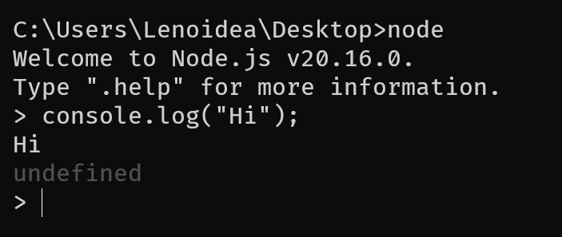
Installation
Node.js should be installed first.
We have talked about Node.js, it is a way to run JS code outside of the browser (a JS runtime environment).
The Node Package Manager (NPM) is used on the command-line to install libraries and more.

Slide 45
Installation
To setup a React project, there are many methods to choose from.
Basic React:
CRA (Create React App): This was the official way to setup projects made by the React team. However, it was removed from the documentations a year ago.
Vite: This is another way to setup a React project. It is much faster and also supports TypeScript.
Full-stack React:
Next.js: This is a full-stack React framework. It supports all features and also server-side rendering. The React documentations seem to recommend using this for all projects.
Remix: Another full-stack React framework.

Slide 46

CRA
We will stick to the CRA method because it is easier to focus on only React.
In options such as Next.js we also have to mind the server features which may not be the best for learning.
To setup a CRA project, use the following command:
npx create-react-app my-app
npx is Node Package Execute which runs a template (create-react-app here).
CRA includes Webpack, Babel, and ESLint.

Slide 47
Structure
The CRA project structure and files are explained in code.
<CODE />

Slide 48
Thank you for your attention.

